Slide 1
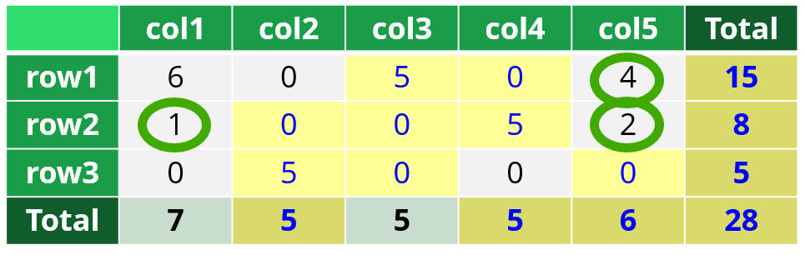
Statistical Disclosure Control (SDC) day 5, part 2
Background of SmallCountRounding
The function PLSrounding in the R package SmallCountRounding
Permuting zeros in SmallCountRounding
06.03.2024

Slide 2
Contents
Background of SmallCountRounding
The function PLSrounding in the R package SmallCountRounding
Permuting zeros in SmallCountRounding

Slide 3
Background of SmallCountRounding

Slide 4
Perturbation – is an alternative to suppression
Perturbation
Values are changed
Small Count Rounding
is a specific perturbation method
This method is additive, ensuring all values are consistent
Total number of men + Total number of women = Total number of people
Small frequencies are avoided

Slide 5
Small example 5 as rounding base
 | col1 | col2 | col3 | col4 | col5 | Total
row1 | 6 | 0 | 1 | 3 | 4 | 14
row2 | 1 | 2 | 3 | 1 | 2 | 9
row3 | 0 | 1 | 1 | 0 | 2 | 4
Total | 7 | 3 | 5 | 4 | 8 | 27
Only row and column totals are to be published
5 as rounding base is used in the examples
In practice, 3 as rounding base is very common
We will prevent frequencies less than 5 being published
Except that zeros can be published

Slide 6
Small example 5 as rounding base
 | col1 | col2 | col3 | col4 | col5 | Total
row1 | 6 | 0 | 1 | 3 | 4 | 14
row2 | 1 | 2 | 3 | 1 | 2 | 9
row3 | 0 | 1 | 1 | 0 | 2 | 4
Total | 7 | 3 | 5 | 4 | 8 | 27
Only row and column totals are to be published
 | col1 | col2 | col3 | col4 | col5 | Total
row1 | 6 | 0 | 1 | 3 | 4 | 14
row2 | 1 | 2 | 3 | 1 | 2 | 9
row3 | 0 | 1 | 1 | 0 | 2 | 4
Total | 7 | 3 | 5 | 4 | 8 | 27
Original

Slide 7
Small example 5 as rounding base
 | col1 | col2 | col3 | col4 | col5 | Total
row1 | 6 | 0 | 1 | 3 | 4 | 15
row2 | 1 | 2 | 3 | 1 | 2 | 8
row3 | 0 | 1 | 1 | 0 | 2 | 5
Total | 7 | 5 | 5 | 5 | 6 | 28
Only row and column totals are to be published
Rounded data
 | col1 | col2 | col3 | col4 | col5 | Total
row1 | 6 | 0 | 1 | 3 | 4 | 14
row2 | 1 | 2 | 3 | 1 | 2 | 9
row3 | 0 | 1 | 1 | 0 | 2 | 4
Total | 7 | 3 | 5 | 4 | 8 | 27
Original

Slide 8
Small example 5 as rounding base
In general additivity and consistency are guaranteed
Frequencies of the cells to be published are recalculated from the rounded inner cells
Corresponds to changing microdata
Inner cells frequencies are frequencies of the unique combinations in microdata
 | col1 | col2 | col3 | col4 | col5 | Total
row1 | 6 | 0 | 5 | 0 | 4 | 15
row2 | 1 | 0 | 0 | 5 | 2 | 8
row3 | 0 | 5 | 0 | 0 | 0 | 5
Total | 7 | 5 | 5 | 5 | 6 | 28
Only row and column totals are to be published
Rounded data
Obtained by rounding small inner cells
 | col1 | col2 | col3 | col4 | col5 | Total
row1 | 6 | 0 | 1 | 3 | 4 | 14
row2 | 1 | 2 | 3 | 1 | 2 | 9
row3 | 0 | 1 | 1 | 0 | 2 | 4
Total | 7 | 3 | 5 | 4 | 8 | 27
Original

Slide 9
Small example 5 as rounding- base
 | col1 | col2 | col3 | col4 | col5 | Total
row1 | 6 | 0 | 5 | 0 | 4 | 15
row2 | 1 | 0 | 0 | 5 | 2 | 8
row3 | 0 | 5 | 0 | 0 | 0 | 5
Total | 7 | 5 | 5 | 5 | 6 | 28
Only row and column totals are to be published
Rounded data
Obtained by rounding small inner cells
But not all of them needed to be rounded
The aim is to limit the rounding to necessary cells
General algorithm based on dummy variable coding

Slide 10
 | col1 | col2 | col3 | col4 | col5 | Total
row1 | 6 | 0 | 1 | 3 | 4 | 14
row2 | 1 | 2 | 3 | 1 | 2 | 9
row3 | 0 | 1 | 1 | 0 | 2 | 4
Total | 7 | 3 | 5 | 4 | 8 | 27
6
1
0
0
2
1
1
3
1
3
1
0
4
2
2
14
9
4
27
7
3
5
4
8

Slide 11
Inner cells
 | col1 | col2 | col3 | col4 | col5 | Total
row1 | 6 | 0 | 1 | 3 | 4 | 14
row2 | 1 | 2 | 3 | 1 | 2 | 9
row3 | 0 | 1 | 1 | 0 | 2 | 4
Total | 7 | 3 | 5 | 4 | 8 | 27
6
1
0
0
2
1
1
3
1
3
1
0
4
2
2
Publishable cells
7
3
5
4
8
14
9
4
27

Slide 12
Inner cells
6
1
0
0
2
1
1
3
1
3
1
0
4
2
2
 | col1 | col2 | col3 | col4 | col5 | Total
row1 | 6 | 0 | 1 | 3 | 4 | 14
row2 | 1 | 2 | 3 | 1 | 2 | 9
row3 | 0 | 1 | 1 | 0 | 2 | 4
Total | 7 | 3 | 5 | 4 | 8 | 27
Publishable cells
7
3
5
4
8
14
9
4
27

Slide 13
T
Inner cells
In general
z = X^{T}y
The output cells can be computed from the inner cells by this matrix multiplication
We have just seen similar computations
As a part of the suppression algorithm
1 | 0 | 0 | 0 | 0 | 1 | 0 | 0 | 1
1 | 0 | 0 | 0 | 0 | 0 | 1 | 0 | 1
1 | 0 | 0 | 0 | 0 | 0 | 0 | 1 | 1
0 | 1 | 0 | 0 | 0 | 1 | 0 | 0 | 1
0 | 1 | 0 | 0 | 0 | 0 | 1 | 0 | 1
0 | 1 | 0 | 0 | 0 | 0 | 0 | 1 | 1
0 | 0 | 1 | 0 | 0 | 1 | 0 | 0 | 1
0 | 0 | 1 | 0 | 0 | 0 | 1 | 0 | 1
0 | 0 | 1 | 0 | 0 | 0 | 0 | 1 | 1
0 | 0 | 0 | 1 | 0 | 1 | 0 | 0 | 1
0 | 0 | 0 | 1 | 0 | 0 | 1 | 0 | 1
0 | 0 | 0 | 1 | 0 | 0 | 0 | 1 | 1
0 | 0 | 0 | 0 | 1 | 1 | 0 | 0 | 1
0 | 0 | 0 | 0 | 1 | 0 | 1 | 0 | 1
0 | 0 | 0 | 0 | 1 | 0 | 0 | 1 | 1
6
1
0
0
2
1
1
3
1
3
1
0
4
2
2
×
Publishable cells
7
3
5
4
8
14
9
4
27
=

Slide 14
Algorithm based on a dummy matrix
The criterion employed is heuristic in nature. However, this criterion facilitates a fast algorithm and, in practice, yields good results.
Start by setting inner cells contributing to unsafe publishable cells to 0.
The forward selection part
Fill inn the required number rounding base values one by one according to a criterion
The iteration part
Improve by setting one of the filled values to zero (according to similar criterion) and fill inn again.
So that the overall total is as close to the truth as possible
The criterion
Fill in the element where $X\tilde{z}$ is maximal (or remove where minimal)
where $\tilde{z}=X^{T}(y−\tilde{y})$ (the difference between true and preliminary rounded values)
where $\tilde{y}$ is the preliminary rounded version of $y$.

Slide 15
Small example 5 as rounding- base
 | col1 | col2 | col3 | col4 | col5 | Total
row1 | 6 | 0 | 5 | 0 | 4 | 15
row2 | 1 | 0 | 0 | 5 | 2 | 8
row3 | 0 | 5 | 0 | 0 | 0 | 5
Total | 7 | 5 | 5 | 5 | 6 | 28
An alternative is to round all inner cells
Or all small inner cells
frequencies < 5
 | col1 | col2 | col3 | col4 | col5 | Total
row1 | 6 | 0 | 0 | 5 | 5 | 16
row2 | 0 | 0 | 5 | 0 | 5 | 10
row3 | 0 | 0 | 0 | 0 | 0 | 0
Total | 6 | 0 | 5 | 5 | 10 | 26
Only row and column totals are to be published (publishable cells)
Rounded data
Obtained by rounding small inner cells
But not all of them needed to be rounded
The aim is to limit the rounding to necessary cells

Slide 16
The function PLSrounding in the R package SmallCountRounding

Slide 17
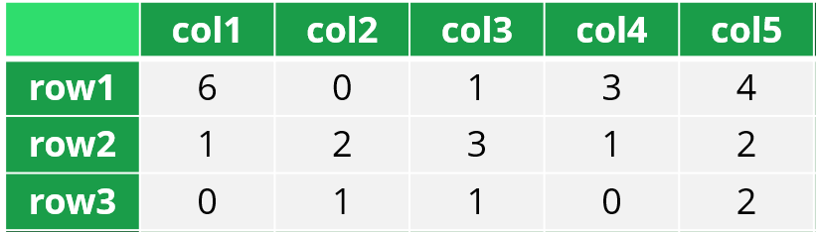
Generate the example data in R
z <- data.frame(rows = c("row1", "row2", "row3", "row1", "row2", "row3",
"row1", "row2", "row3", "row1", "row2", "row3",
"row1", "row2", "row3"),
cols = c("col1", "col1", "col1", "col2", "col2", "col2",
"col3", "col3", "col3", "col4", "col4", "col4",
"col5", "col5", "col5"),
freq = c(6, 1, 0, 0, 2, 1, 1, 3, 1, 3, 1, 0, 4, 2, 2))
> z
rows cols freq
1 row1 col1 6
2 row2 col1 1
3 row3 col1 0
4 row1 col2 0
5 row2 col2 2
6 row3 col2 1
7 row1 col3 1
8 row2 col3 3
9 row3 col3 1
10 row1 col4 3
11 row2 col4 1
12 row3 col4 0
13 row1 col5 4
14 row2 col5 2
15 row3 col5 2
To illustrate

Slide 18
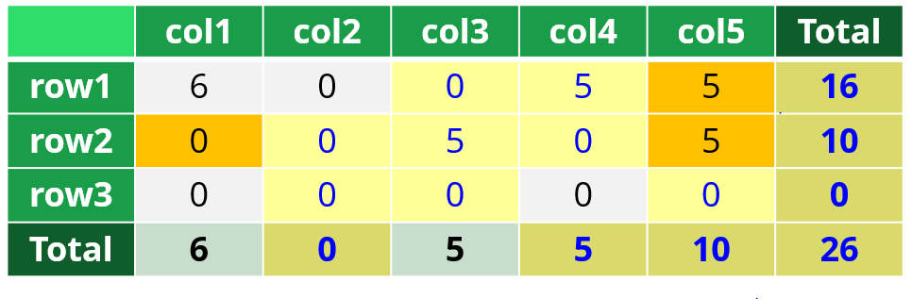
All values are to be published
> PLSroundingPublish(z, freqVar = "freq", dimVar = c("rows", "cols"), roundBase = 5, rndSeed = 12345)
rows cols original rounded difference
1 Total Total 27 26 -1
2 Total col1 7 6 -1
3 Total col2 3 0 -3
4 Total col3 5 5 0
5 Total col4 4 5 1
6 Total col5 8 10 2
7 row1 Total 14 16 2
8 row1 col1 6 6 0
9 row1 col2 0 0 0
10 row1 col3 1 0 -1
11 row1 col4 3 5 2
12 row1 col5 4 5 1
13 row2 Total 9 10 1
14 row2 col1 1 0 -1
15 row2 col2 2 0 -2
16 row2 col3 3 5 2
17 row2 col4 1 0 -1
18 row2 col5 2 5 3
19 row3 Total 4 0 -4
20 row3 col1 0 0 0
21 row3 col2 1 0 -1
22 row3 col3 1 0 -1
23 row3 col4 0 0 0
24 row3 col5 2 0 -2
Now, we execute a rounding functions with these data as input
Input is similar to input from suppression functions
Output is similar to output from suppression functions
Now with original and rounded frequencies in output
Why this function name and why rndSeed will be mentioned later
Since dimVar is used
All small inner cells must be rounded anyway

Slide 19
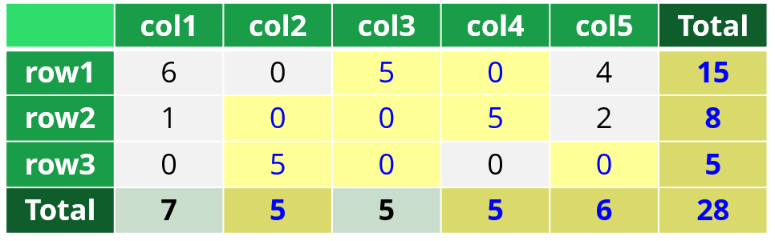
Only row and column totals are to be published
> PLSroundingPublish(z, freqVar = "freq", formula = ~rows + cols, roundBase = 5)
rows cols original rounded difference
1 Total Total 27 28 1
2 row1 Total 14 15 1
3 row2 Total 9 8 -1
4 row3 Total 4 5 1
5 Total col1 7 7 0
6 Total col2 3 5 2
7 Total col3 5 5 0
8 Total col4 4 5 1
9 Total col5 8 6 -2
But we cannot see these inner cells in output
Since formula = ~rows + cols is used
Only necessary cells rounded

Slide 20
Two datasets in output from PLSrounding
> output <- PLSrounding(z, freqVar = "freq", formula = ~rows + cols, roundBase = 5)
> output$inner
rows cols original rounded difference
1 row1 col1 6 6 0
2 row2 col1 1 1 0
3 row3 col1 0 0 0
4 row1 col2 0 0 0
5 row2 col2 2 0 -2
6 row3 col2 1 5 4
7 row1 col3 1 0 -1
8 row2 col3 3 5 2
9 row3 col3 1 0 -1
10 row1 col4 3 5 2
11 row2 col4 1 0 -1
12 row3 col4 0 0 0
13 row1 col5 4 4 0
14 row2 col5 2 2 0
15 row3 col5 2 0 -2
> output$publish
rows cols original rounded difference
1 Total Total 27 28 1
2 row1 Total 14 15 1
3 row2 Total 9 8 -1
4 row3 Total 4 5 1
5 Total col1 7 7 0
6 Total col2 3 5 2
7 Total col3 5 5 0
8 Total col4 4 5 1
9 Total col5 8 6 -2
Now we can see them
We have switched from PLSroundingPublish to PLSrounding
With PLSroundingPublish, we have only this data frame in output
inner
publish

Slide 21
When printing output from PLSrounding
> output
PLSrounding summary:
maxdiff HDutility meanAbsDiff rootMeanSquare
2 0.941 1 1.2019
Frequencies of cell frequencies and absolute differences:
inn.0 inn.1-4 inn.5 inn.6+ inn.all pub.0 pub.1-4 pub.5 pub.6+ pub.all
original 3 11 . 1 15 . 3 1 5 9
rounded 8 3 3 1 15 . . 4 5 9
absDiff 7 8 . . 15 2 7 . . 9
Some summary information is printed
Explanation can be found in the vignette
https://cran.r-project.org/web/packages/SmallCountRounding/vignettes/Introduction_to_SmallCountRounding.html

Slide 22
The parameter rndSeed
The current version of this R package consistently produces the same output for identical inputs
Other results can be obtained by specifying a seed for the random number generator
Above, rndSeed was used to achieve the same result as the example tables created earlier
Usually, you don't need to use rndSeed, but it can be nice if you want to try to get other results

Slide 23
Small example 5 as rounding- base
Rounding all inner cells is achieved with the parameter
forceInner = TRUE
Rounding all small inner cells is achieved with the parameter
allSmall = TRUE
 | col1 | col2 | col3 | col4 | col5 | Total
row1 | 6 | 0 | 5 | 0 | 4 | 15
row2 | 1 | 0 | 0 | 5 | 2 | 8
row3 | 0 | 5 | 0 | 0 | 0 | 5
Total | 7 | 5 | 5 | 5 | 6 | 28
An alternative is to round all inner cells
Or all small inner cells
frequencies < 5
 | col1 | col2 | col3 | col4 | col5 | Total
row1 | 6 | 0 | 0 | 5 | 5 | 16
row2 | 0 | 0 | 5 | 0 | 5 | 10
row3 | 0 | 0 | 0 | 0 | 0 | 0
Total | 6 | 0 | 5 | 5 | 10 | 26
Only row and column totals are to be published (publishable cells)
Rounded data
Obtained by rounding small inner cells
But not all of them needed to be rounded
The aim is to limit the rounding to necessary cells

Slide 24
Permuting zeros in SmallCountRounding

Slide 25
With zeroCandidates = TRUE
> output <- PLSrounding(z, freqVar = "freq", formula = ~rows + cols, roundBase = 5, zeroCandidates = TRUE)
> output$inner
rows cols original rounded difference
1 row1 col1 6 6 0
2 row2 col1 1 1 0
3 row3 col1 0 0 0
4 row1 col2 0 0 0
5 row2 col2 2 5 3
6 row3 col2 1 0 -1
7 row1 col3 1 5 4
8 row2 col3 3 0 -3
9 row3 col3 1 0 -1
10 row1 col4 3 0 -3
11 row2 col4 1 0 -1
12 row3 col4 0 5 5
13 row1 col5 4 4 0
14 row2 col5 2 2 0
15 row3 col5 2 0 -2
> output$publish
rows cols original rounded difference
1 Total Total 27 28 1
2 row1 Total 14 15 1
3 row2 Total 9 8 -1
4 row3 Total 4 5 1
5 Total col1 7 7 0
6 Total col2 3 5 2
7 Total col3 5 5 0
8 Total col4 4 5 1
9 Total col5 8 6 -2
Zeros in inner cells are allowed to be “rounded up”
Thus, zeros in cells to be published may also be “rounded up”
Here, row3:col4 is rounded up

Slide 26
Structural Zeros
must be taken into account if zeros are to be perturbed
must not be included as candidates to be rounded up

Slide 27
A grid example

Slide 28
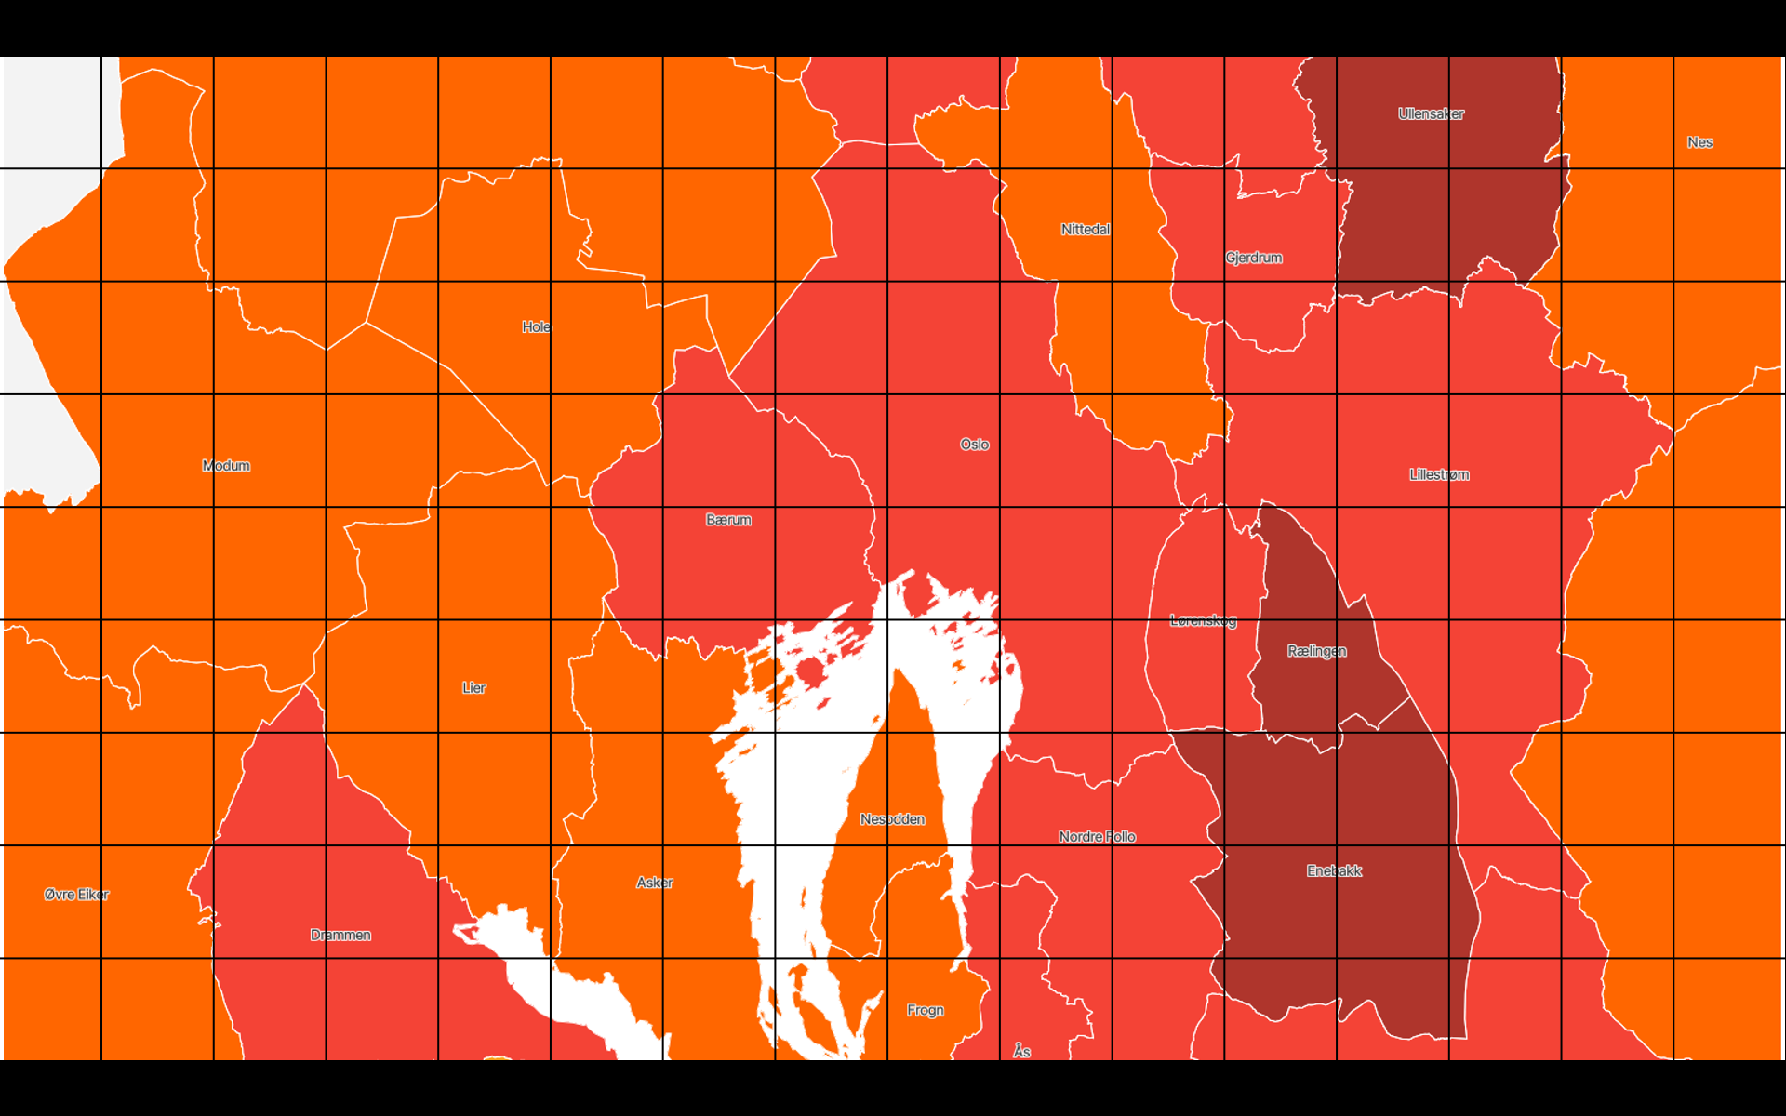

Slide 29
my_km²
We will look at data and results from a single km² square.
But not real data and not a real km² square.

Slide 30
SmallCountRounding - grid example
Input data with geographic information and Age and Sex
> z
Square250m Square1000m Municipality Age Sex freq
1 500_000 my_km² Oslo 15_to_65 female 3
2 500_000 my_km² Oslo 15_to_65 male 2
3 500_000 my_km² Oslo under_15 male 1
4 750_250 my_km² Nittedal 15_to_65 female 2
5 750_250 my_km² Nittedal 15_to_65 male 2
6 750_250 my_km² Nittedal under_15 female 1
7 750_250 my_km² Nittedal under_15 male 1
8 750_500 my_km² Nittedal 65_and_over female 1
9 750_500 my_km² Nittedal 65_and_over male 1
10 750_500 my_km² Oslo 15_to_65 female 1
: : another_km² : : : :
: : : : : : :
> a <- PLSrounding(z, "freq", formula = ~Sex*Age*Municipality*Square1000m + Square250m)
> a$inner
Square250m Municipality Age Sex original rounded difference
1 500_000 Oslo 15_to_65 female 3 3 0
2 500_000 Oslo 15_to_65 male 2 3 1
3 500_000 Oslo under_15 male 1 0 -1
4 750_250 Nittedal 15_to_65 female 2 0 -2
5 750_250 Nittedal 15_to_65 male 2 3 1
6 750_250 Nittedal under_15 female 1 3 2
7 750_250 Nittedal under_15 male 1 0 -1
8 750_500 Nittedal 65_and_over female 1 0 -1
9 750_500 Nittedal 65_and_over male 1 0 -1
10 750_500 Oslo 15_to_65 female 1 0 -1
: : : : : : : :
Inner cells are similar to input data
But Square1000m is not needed because of the hierarchical relation
Inner cells contain rounded values

Slide 31
SmallCountRounding results formula = ~Sex*Age*Municipality*Square1000m + Square250m
> a$publish
Square250m Municipality Age Sex original rounded difference
1 500_000 Total Total Total 6 6 0
2 750_250 Total Total Total 6 6 0
3 750_500 Total Total Total 3 0 -3
4 my_km² Nittedal 15_to_65 female 2 0 -2
5 my_km² Nittedal 15_to_65 male 2 3 1
6 my_km² Nittedal 15_to_65 Total 4 3 -1
7 my_km² Nittedal 65_and_over female 1 0 -1
8 my_km² Nittedal 65_and_over male 1 0 -1
9 my_km² Nittedal 65_and_over Total 2 0 -2
10 my_km² Nittedal Total female 4 3 -1
11 my_km² Nittedal Total male 4 3 -1
12 my_km² Nittedal Total Total 8 6 -2
13 my_km² Nittedal under_15 female 1 3 2
14 my_km² Nittedal under_15 male 1 0 -1
15 my_km² Nittedal under_15 Total 2 3 1
16 my_km² Oslo 15_to_65 female 4 3 -1
17 my_km² Oslo 15_to_65 male 2 3 1
18 my_km² Oslo 15_to_65 Total 6 6 0
19 my_km² Oslo Total female 4 3 -1
20 my_km² Oslo Total male 3 3 0
21 my_km² Oslo Total Total 7 6 -1
22 my_km² Oslo under_15 male 1 0 -1
23 my_km² Oslo under_15 Total 1 0 -1
24 my_km² Total 15_to_65 female 6 3 -3
25 my_km² Total 15_to_65 male 4 6 2
26 my_km² Total 15_to_65 Total 10 9 -1
27 my_km² Total 65_and_over female 1 0 -1
28 my_km² Total 65_and_over male 1 0 -1
29 my_km² Total 65_and_over Total 2 0 -2
30 my_km² Total Total female 8 6 -2
31 my_km² Total Total male 7 6 -1
32 my_km² Total Total Total 15 12 -3
33 my_km² Total under_15 female 1 3 2
34 my_km² Total under_15 male 2 0 -2
35 my_km² Total under_15 Total 3 3 0
Not crossed with other variables
Only totals
Therefore, only the total number of persons in these 250 meter squares.

Slide 32
> a$publish
Square250m Municipality Age Sex original rounded difference
1 500_000 Total Total Total 6 6 0
2 750_250 Total Total Total 6 6 0
3 750_500 Total Total Total 3 0 -3
4 my_km² Nittedal 15_to_65 female 2 0 -2
5 my_km² Nittedal 15_to_65 male 2 3 1
6 my_km² Nittedal 15_to_65 Total 4 3 -1
7 my_km² Nittedal 65_and_over female 1 0 -1
8 my_km² Nittedal 65_and_over male 1 0 -1
9 my_km² Nittedal 65_and_over Total 2 0 -2
10 my_km² Nittedal Total female 4 3 -1
11 my_km² Nittedal Total male 4 3 -1
12 my_km² Nittedal Total Total 8 6 -2
13 my_km² Nittedal under_15 female 1 3 2
14 my_km² Nittedal under_15 male 1 0 -1
15 my_km² Nittedal under_15 Total 2 3 1
16 my_km² Oslo 15_to_65 female 4 3 -1
17 my_km² Oslo 15_to_65 male 2 3 1
18 my_km² Oslo 15_to_65 Total 6 6 0
19 my_km² Oslo Total female 4 3 -1
20 my_km² Oslo Total male 3 3 0
21 my_km² Oslo Total Total 7 6 -1
22 my_km² Oslo under_15 male 1 0 -1
23 my_km² Oslo under_15 Total 1 0 -1
24 my_km² Total 15_to_65 female 6 3 -3
25 my_km² Total 15_to_65 male 4 6 2
26 my_km² Total 15_to_65 Total 10 9 -1
27 my_km² Total 65_and_over female 1 0 -1
28 my_km² Total 65_and_over male 1 0 -1
29 my_km² Total 65_and_over Total 2 0 -2
30 my_km² Total Total female 8 6 -2
31 my_km² Total Total male 7 6 -1
32 my_km² Total Total Total 15 12 -3
33 my_km² Total under_15 female 1 3 2
34 my_km² Total under_15 male 2 0 -2
35 my_km² Total under_15 Total 3 3 0

Slide 33
Remarks and Reflections

Slide 34
Similarities and Differences with Respect to the Suppression Functions
dimVar, formula, hierarchies and preAggregate are similar
extend0 is not yet a SmallCountRounding parameter
The Extend0 function in SSBtools can be run in advance
Running FormulaSelection on SmallCountRounding output is not yet possible
There are many SmallCountRounding parameters that are not mentioned in this introduction

Slide 35
Disclosure in a Frequency Table
Earlier Slide
We saw that zeros and ones led to disclosure
 | young | middle | old | Total
female | 3 | 2 | 0 | 5
male | 1 | 3 | 3 | 7
Total | 4 | 5 | 3 | 12
Gender sensitive and age identifying
Given age is old → The gender is male
Disclosure is possible due to a cell value of 0
The individual who is young and male knows that all other young individuals are female
Disclosure is possible due to a cell value of 1
Age sensitive and gender identifying
Given gender is female → Age is not old
Negative disclosure is possible due to a cell value of 0
The individual who is young and male knows that no other male individuals are young
Negative disclosure is possible due to a cell value of 1

Slide 36

Primary Suppression of Small Counts in Frequency Tables
Earlier Slide
 | young | middle | old | Total
female | 3 | 2 | 0 | 5
male | 1 | 3 | 3 | 7
Total | 4 | 5 | 3 | 12
Cells with a frequency less than or equal to a certain threshold are primary suppressed

Slide 37
Now, Small Count Rounding
Easy disclosure based on zeros is no longer possible
Since a zero cannot be trusted to be a true zero
Disclosure where a single unit could use information about itself is no longer possible
Since no ones can be seen
With roundBase>2
Even better safeguard
This also prevents perceived disclosure, ensuring that individuals cannot identify themselves in the table.

Slide 38
Permuting Zeros Can be Important
Without perturbing zeros
Any non-zero frequency discloses that at least one record has a certain combination of attributes.
Without perturbing zeros in grid statistics
This is about grid cells where it is known that only one person lives.
Even if the frequency changes from 1 to 3, it will be apparent that these attributes belong to this specific individual.

Slide 39
Exercises, frequency tables (previous presentation)
exercises/structural_zeros.md
Direct link:
https://github.com/statisticsnorway/kurs-metode-sdc-2024/blob/main/exercises/structural_zeros.md
Exercises, SmallCountRounding (this presentation)
exercises/small_count_rounding.md
Direct link:
https://github.com/statisticsnorway/kurs-metode-sdc-2024/blob/main/exercises/small_count_rounding.md

